Slide 1
Way out to promote a journal in post pandemic world
Haibao Xue
Director of Compuscript Asia Pacific and Managing Director of ISE China
www.compuscript.com
www.internationalscienceediting.cn

Slide 2
Major points
Social media
Virtual conference
Junior Editorial Board Members
ScienceOpen featured collection

Slide 3
Social media--WeChat
WeChat (微信) is a free chat app for mobiles that offers free video and voice calls, videos, images, games, stickers and text messages to help you stay connected with people who matter most. It is the most popular social media software used in China.
Publishers set up WeChat accounts to engage with readers/authors/reviewers/editors

Slide 4
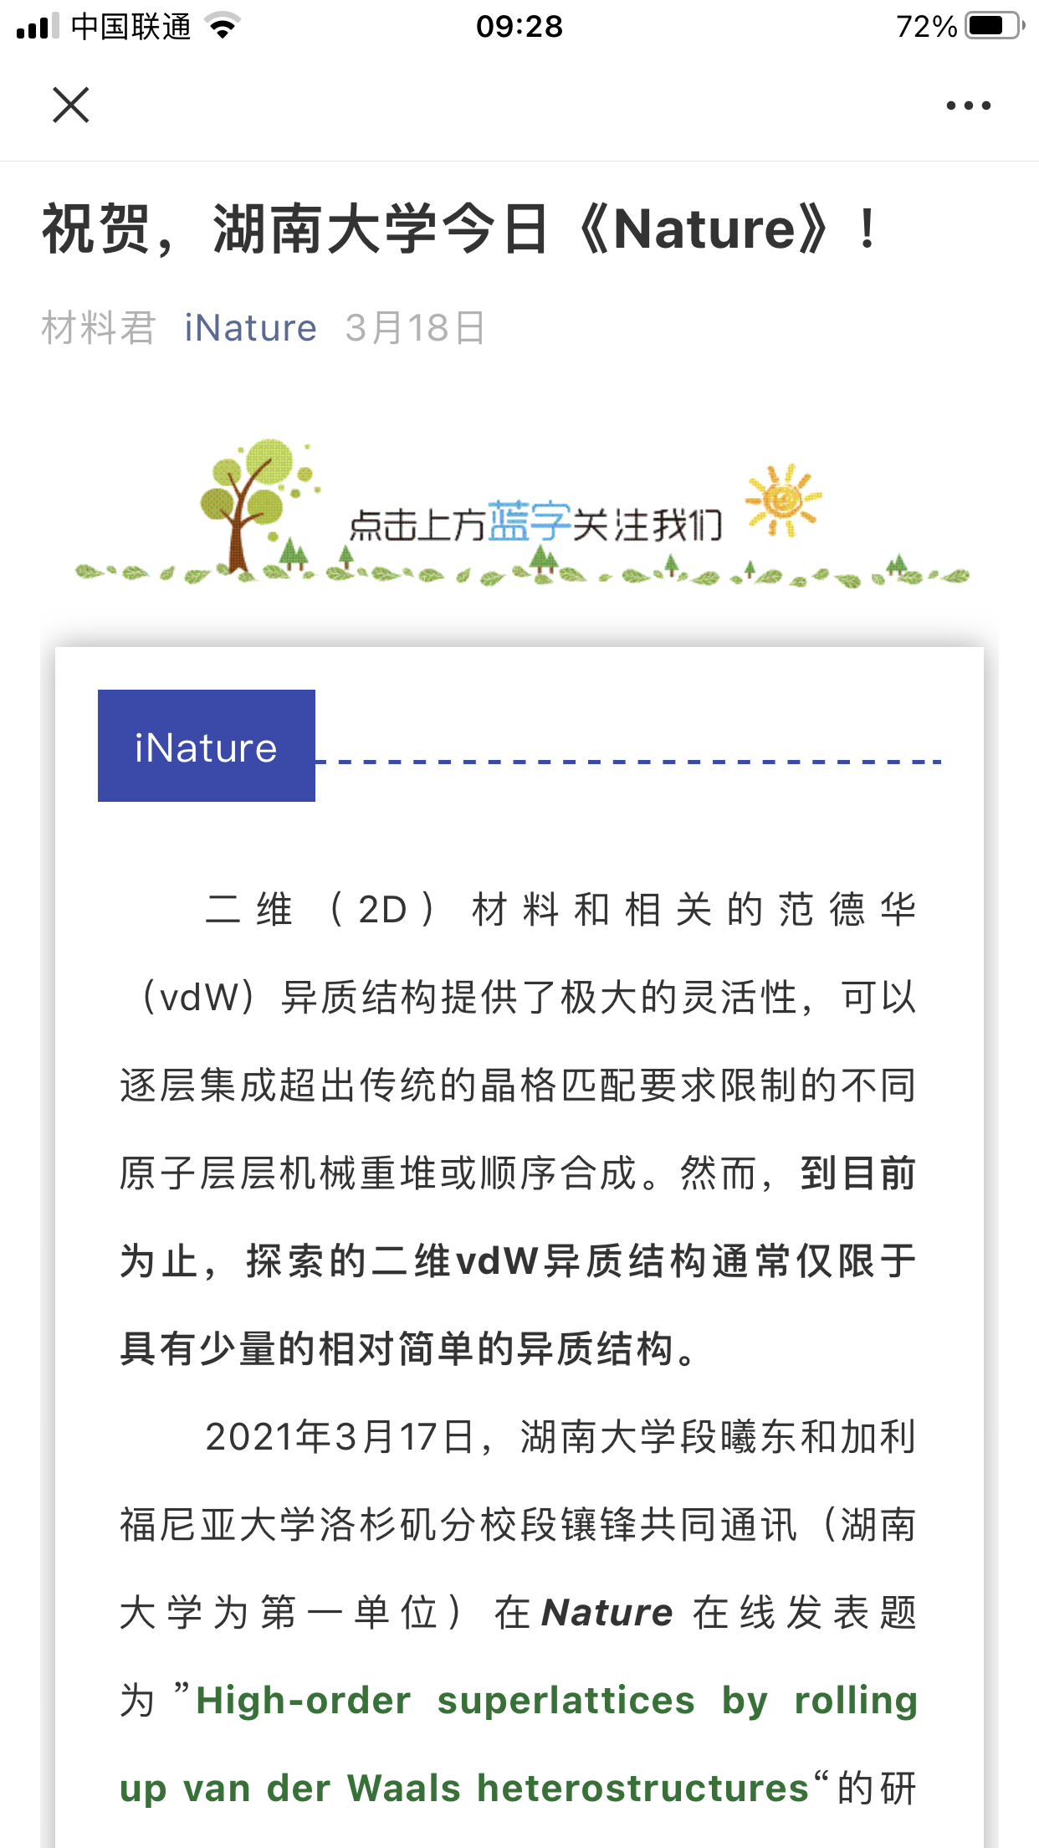
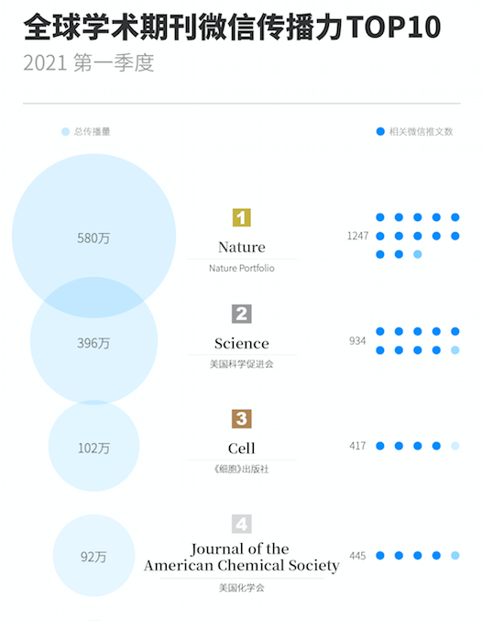
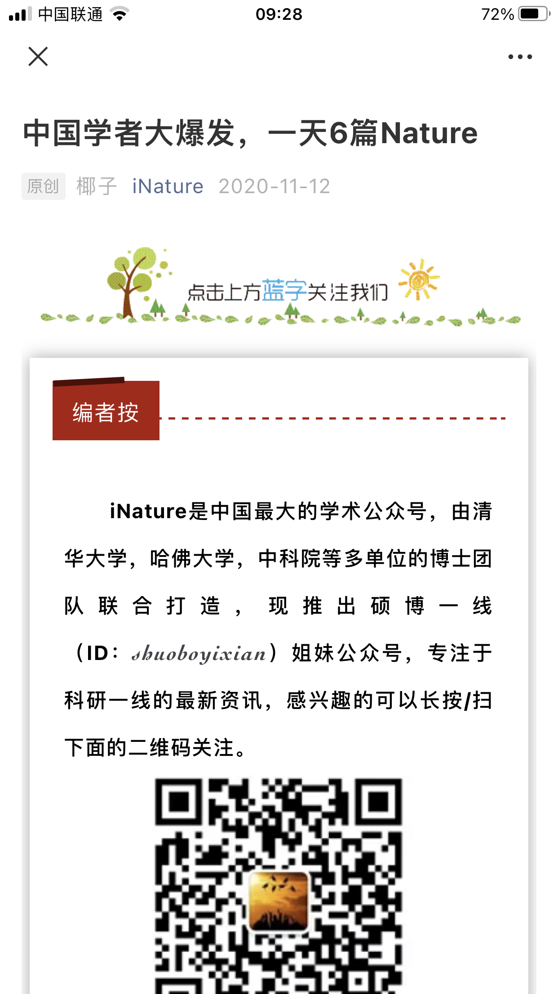
Social media--WeChat
In January-March 2021, Rankings of Academic Journals were reported
14,000 WeChat tweets from 500 journals.
21.83 million reads.
Top 10 journals were specially reported by more than 5000 Wechat tweets, and received more than 15.8 million reads, accounting for more than 70% of the total reads.

Slide 5
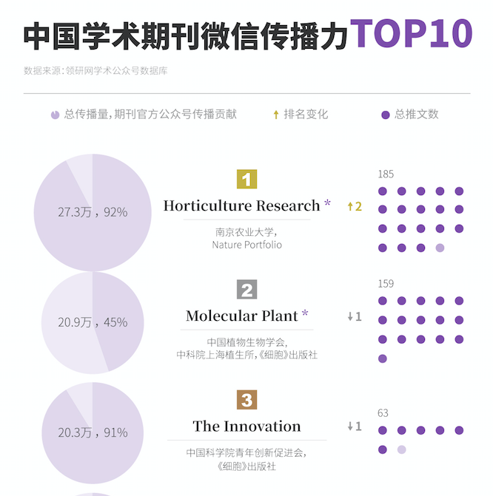
Social media--WeChat
In April-June2021, Rankings of Academic Journals Impact on WeChat in China:
649 influential academic accounts in various disciplines were analyzed.
90,000 posts released
1,300 international academic journals on the wechat platform

Slide 6
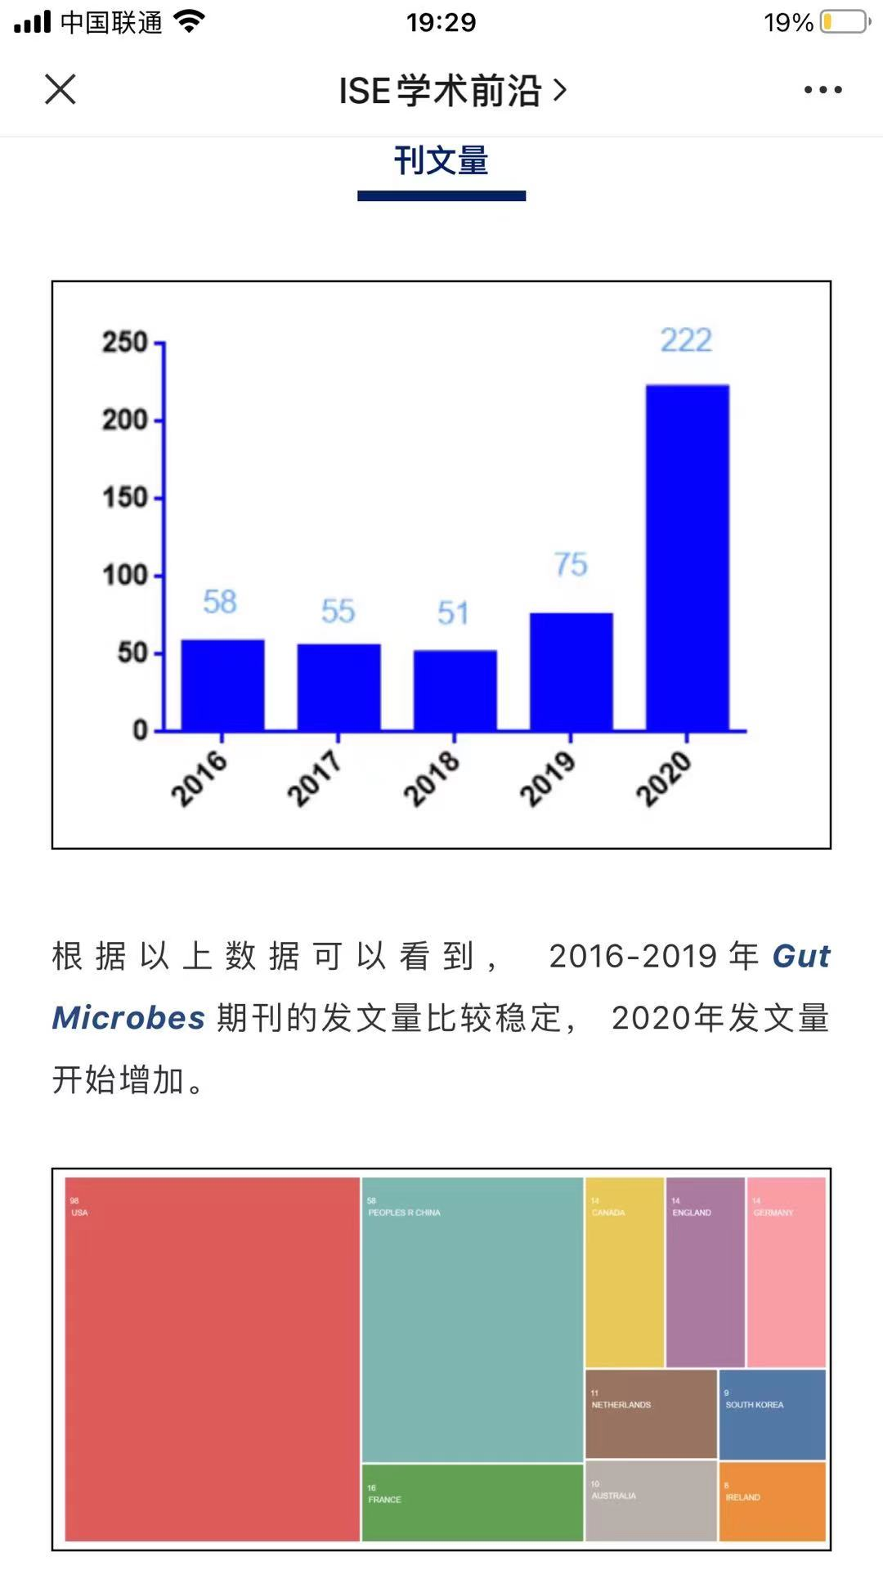
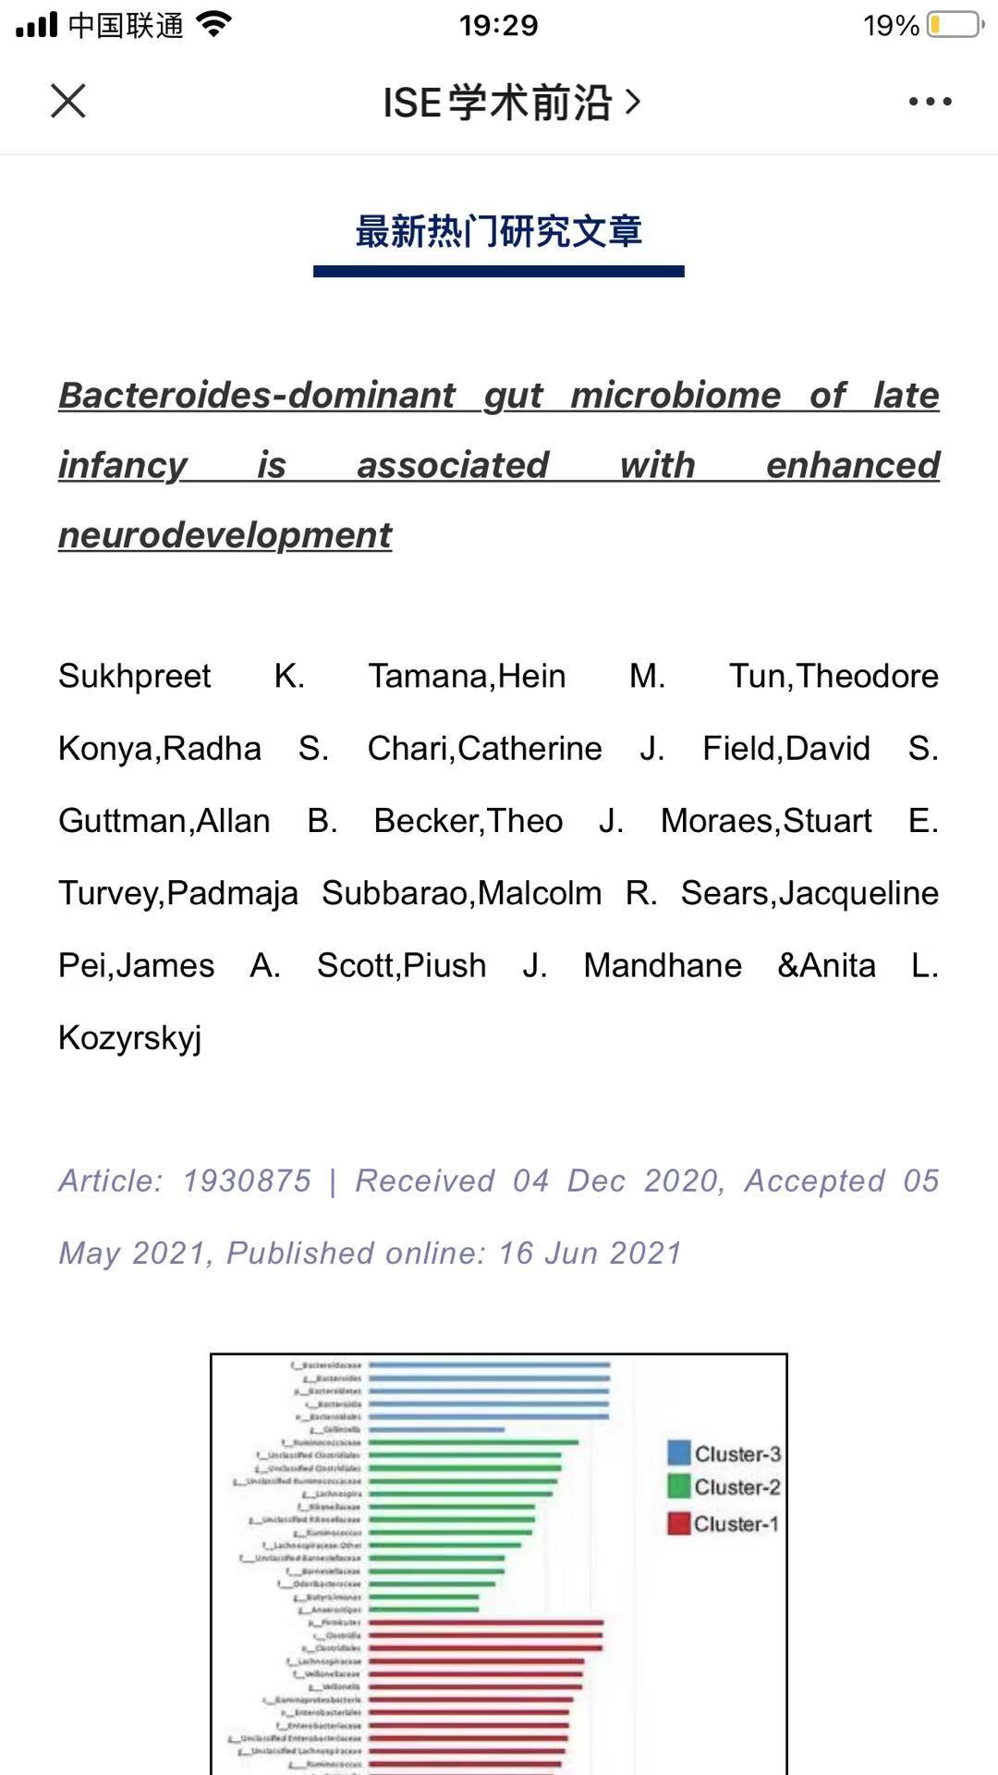
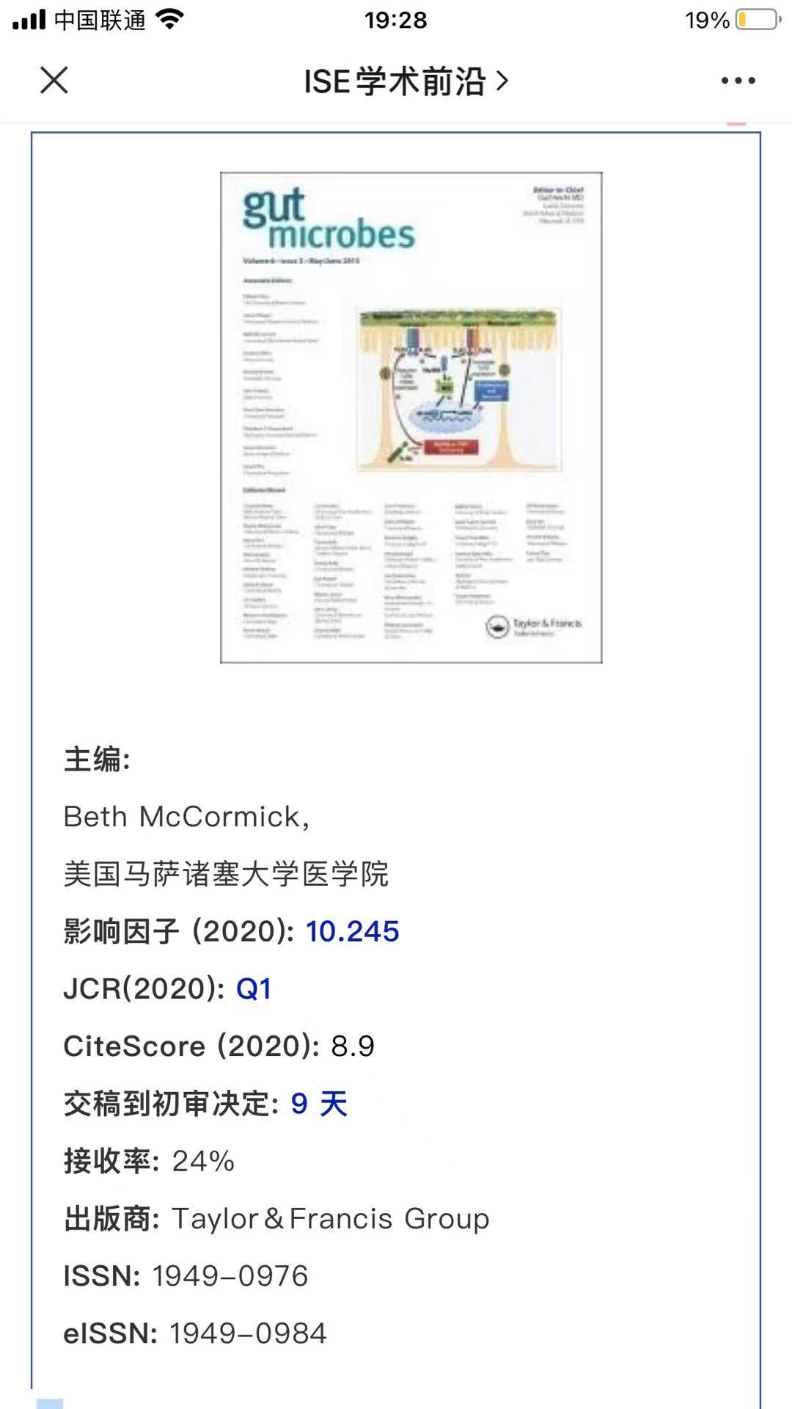
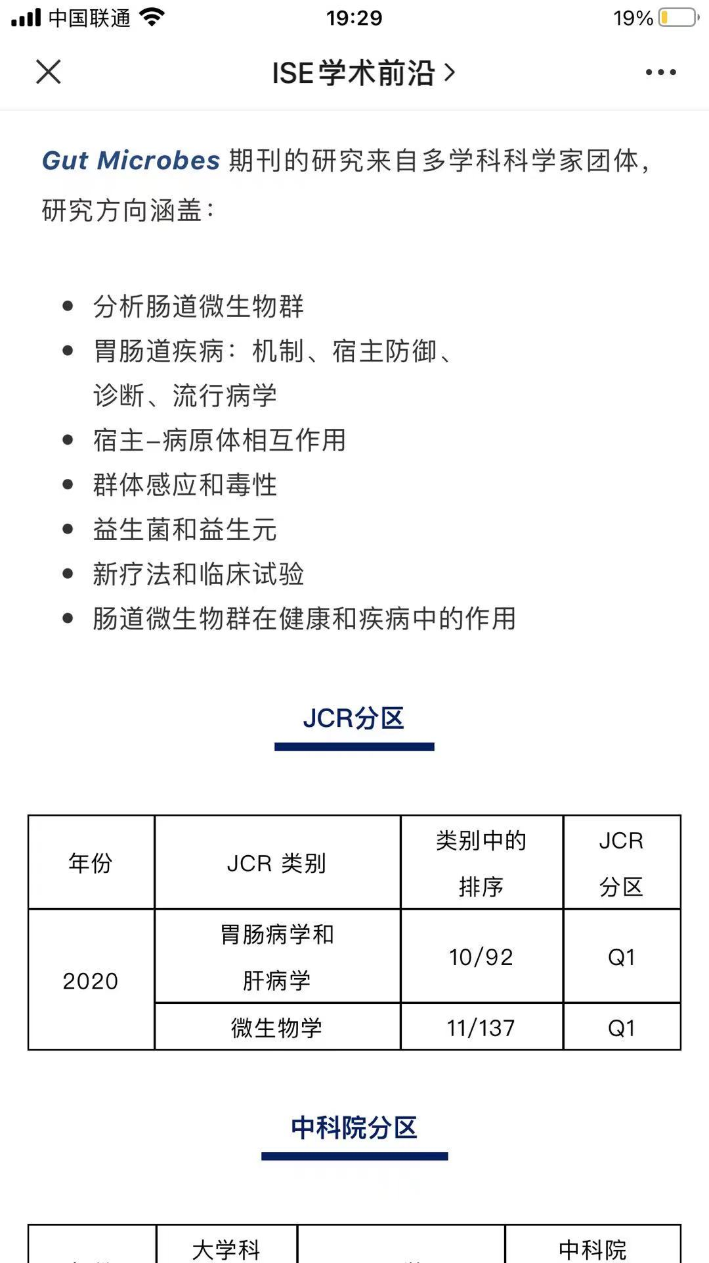
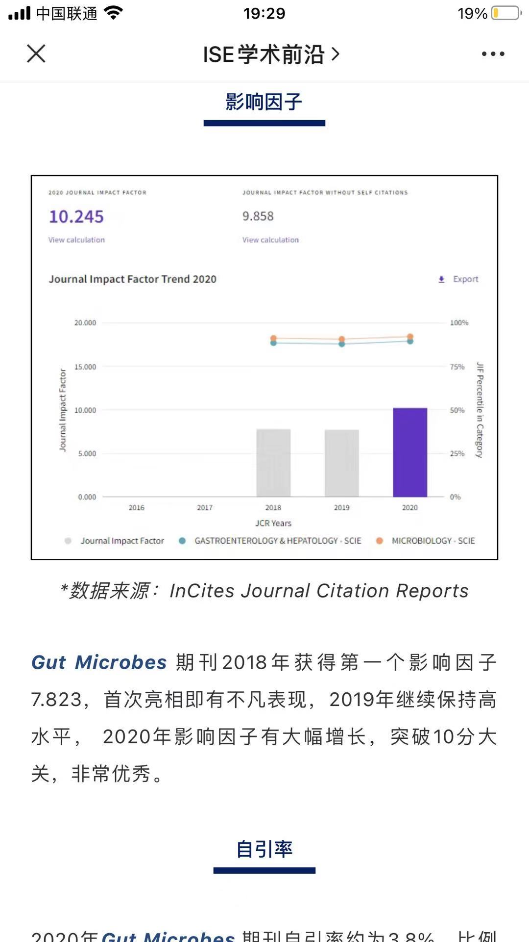
Social media--WeChat
Typical journal promotion tweet on WeChat

Slide 7
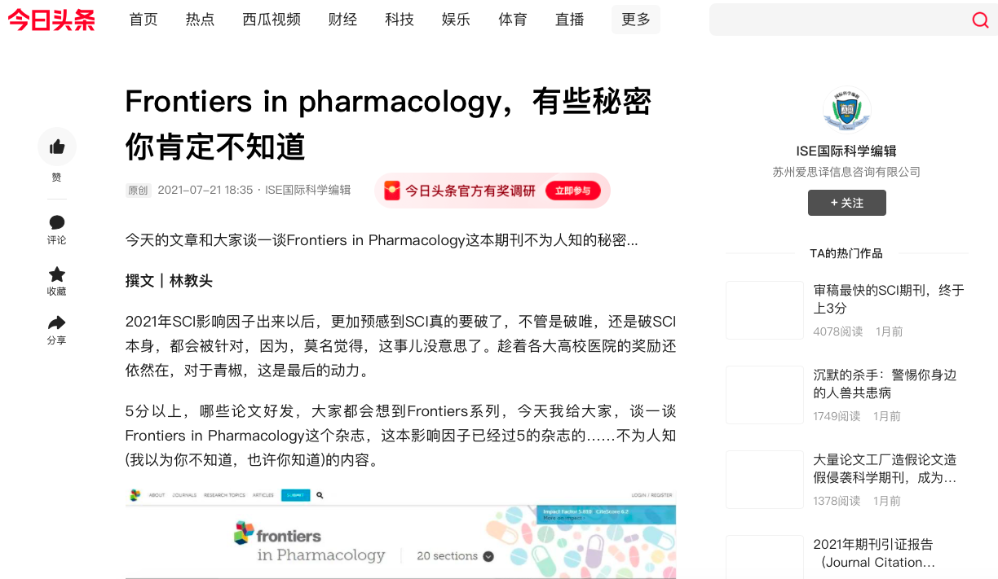
Social media--Toutiao
TouTiao.comToutiao(今日头条) is one of China's largest mobile platforms of content creation, aggregation and distribution underpinned by machine learning techniques, with 120 million daily active users.

Slide 8
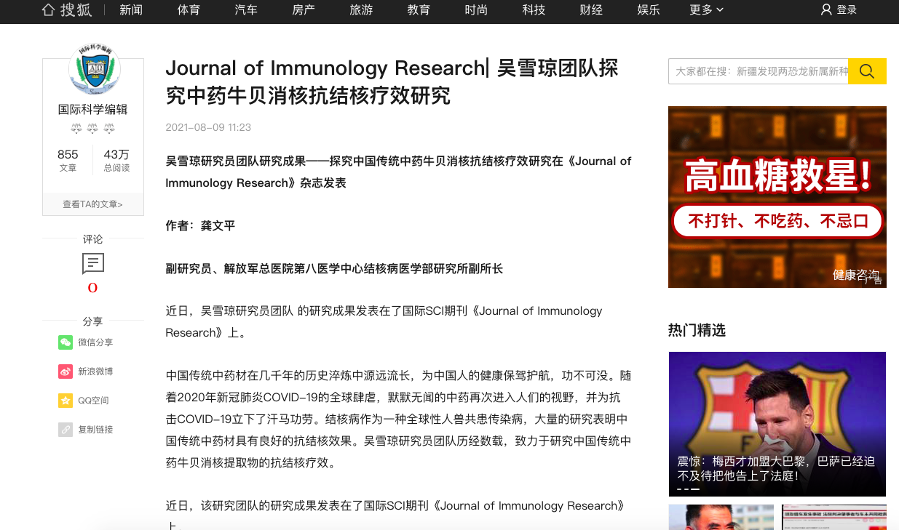
Social media-- Sohu
Sohu is a news portal very similar to a small Yahoo where all kinds of news and videos can be displayed.

Slide 9
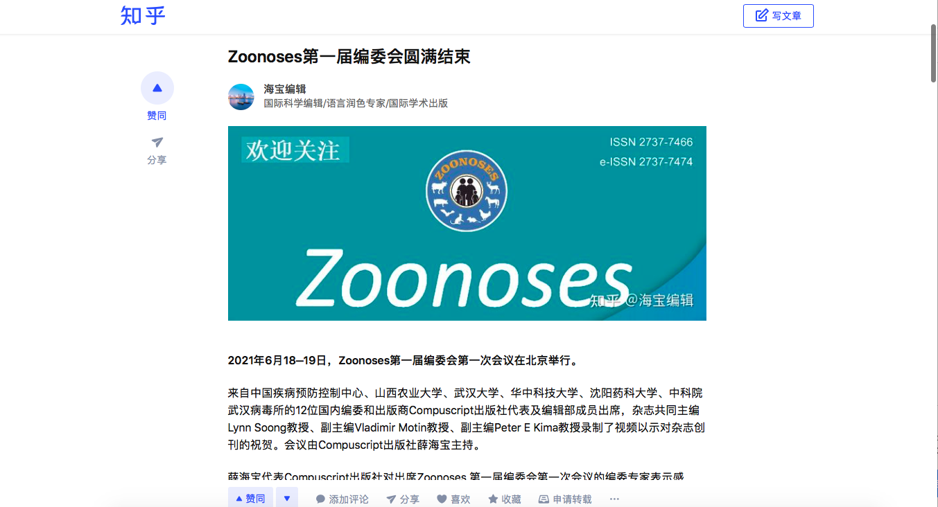
Social media-- Zhihu
Zhihu is a Chinese question-and-answer website where all kinds of questions are created, answered, edited and organized by the community of its users.

Slide 10
Social media-- biomart.cn
Biomart.cn is one of DXY’s sub-branch. DXY.cn, a Chinese medical community site that has over 5 million registered users. Most of them are clinical doctors, biomedical researchers and pharma R&D scientists.

Slide 11
Social media-- ScienceNet.cn
ScienceNet.cn (Chinese: 科学网) is the most high-profile and high-quality Chinese scientists’ blog community in the world.
To encourage responsible behavior, all bloggers must use their real names. Most bloggers are established academic scientists, industrial scientists, science policy makers, funding project managers, science journalists, journal editors and publishers.
It also welcomes self-motivated and ambitious PhD candidates.

Slide 12
Virtual conference
In the first half year, BIO Integration has held more than 5 times virtual conferences.
The audience includes editors, potential readers/authors.
The format includes how to prepare a manuscript to academic exchange
BIOI academic seminars of five regions of China
All virtual meetings are promoted via WeChat.

Slide 13
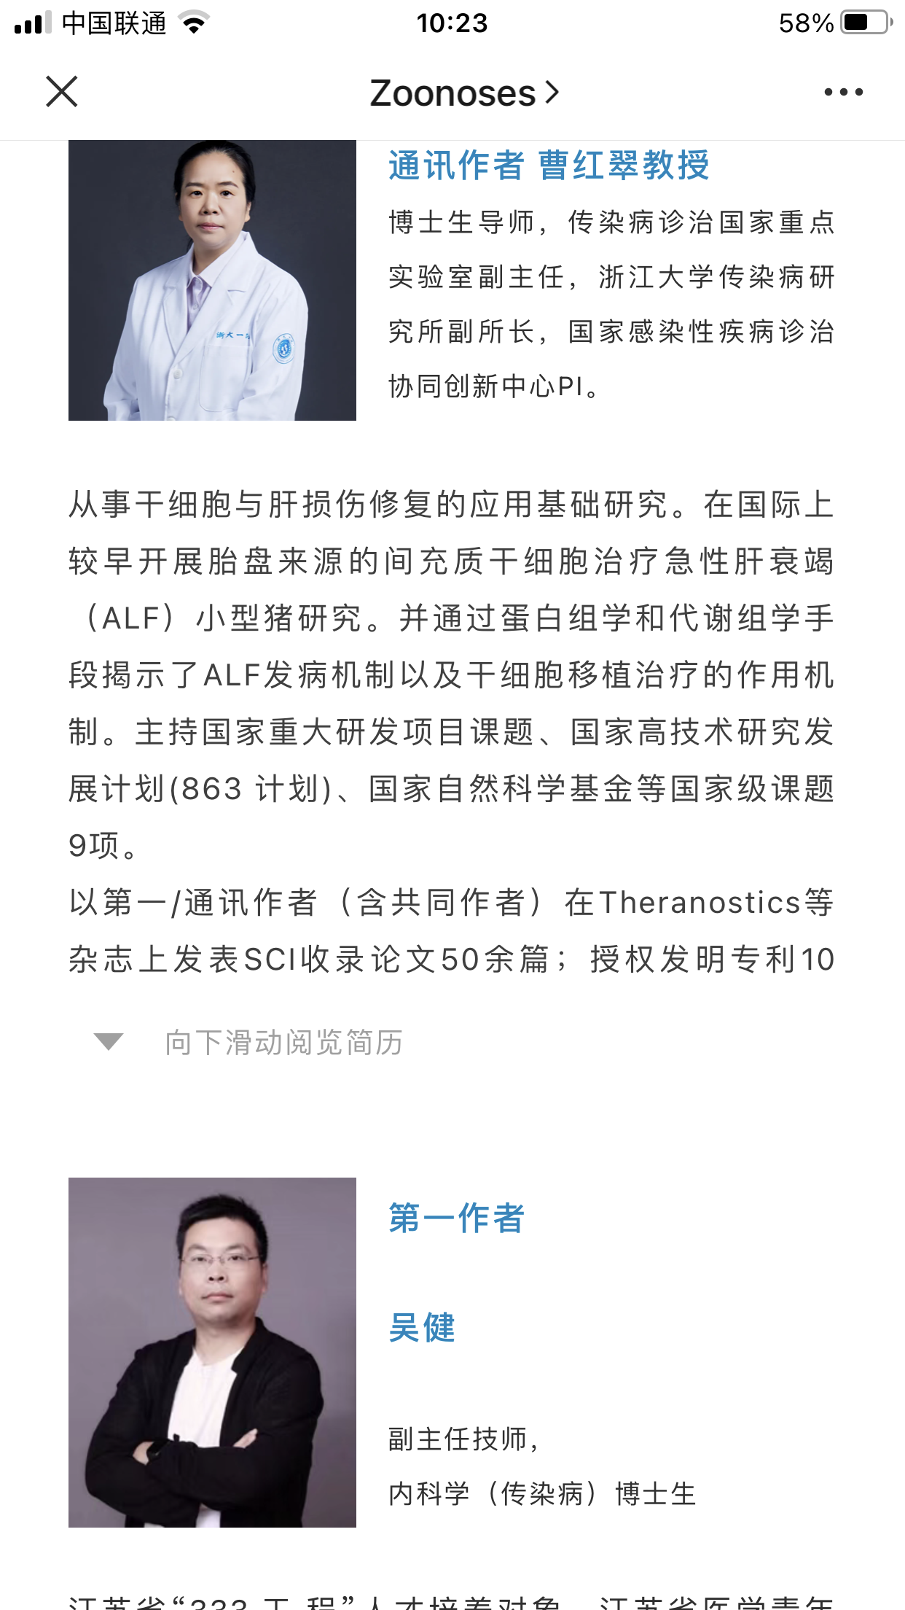
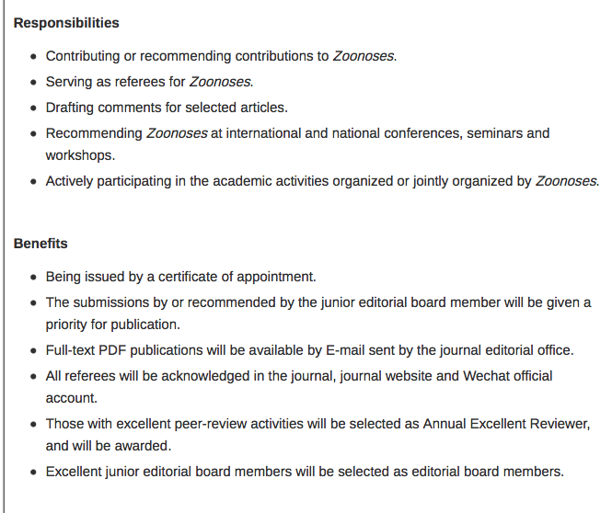
Junior Editorial Board Members
Active
Young
Enthusiastic

Slide 14
ScienceOpen
ScienceOpen Discovery
60 million research article records
23 million authors
25 thousand journals
Goal: Unlock the context around each article to reach a wider interdisciplinary academic audience with ScienceOpen.
ScienceOpen Services: Make your content stand out

Slide 15
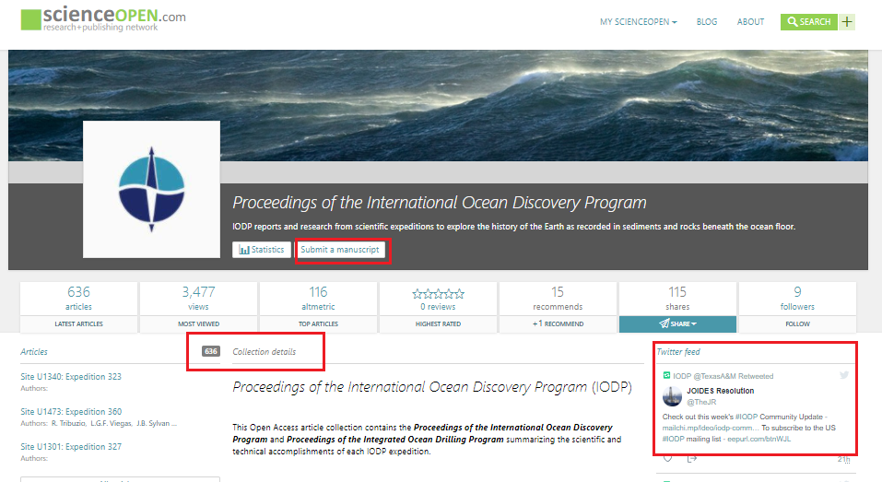
ScienceOpen
Featured Collections: Curated by publisher to increase brand awareness of publisher or journal within a certain discipline.
Researcher-led Collections: Curated by researchers to promote their work, highlight interdisciplinary fields, start a discussion.

Slide 16
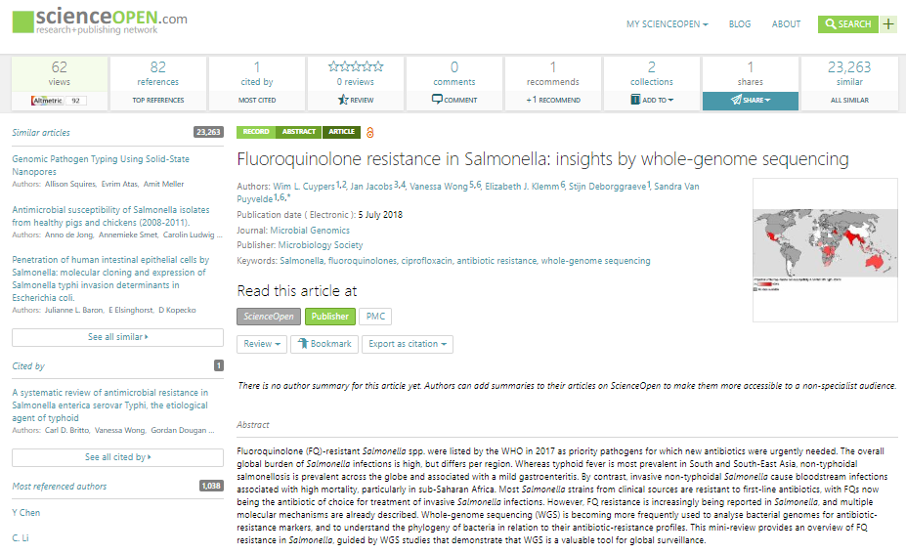
An interactive environment for your article -- regardless of license
INTERACTION
Peer review
Recommend
Comment
Share
CONTEXT
Linked authors
Related collections
Similar articles
METRICS
Altmetric score, citations, usage

Slide 17
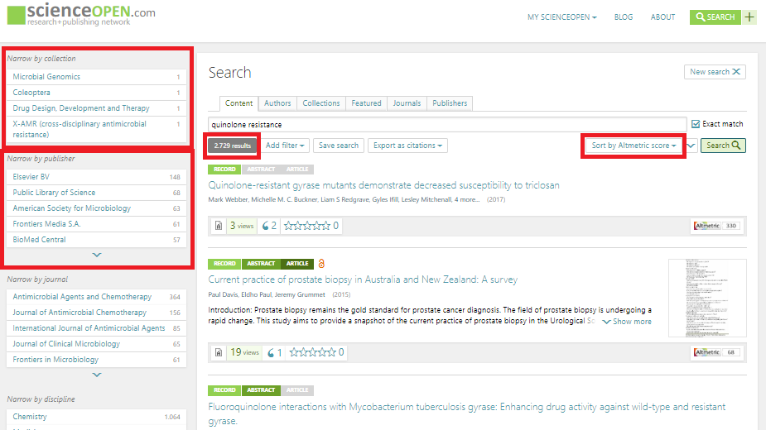
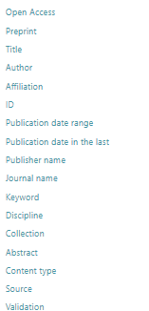
Your content embedded in a discovery environment and highlighted by Collection

Slide 18
A full suite of usage statistics

Slide 19
Our Future Vision for Compuscript
“When you go with Compuscript, you are getting far more than technology, you are getting access to our core strength, our people”
Contact：
Haibao Xue
Phone：086-18606216306
Email: haibao@compuscript.com

